Slide 1
Validations and Error Handling

Slide 2
Adding validation rules in a fusion web application
A typical enterprise application may want to perform certain validations at client-side and certain things at server-side. The idea is to detect and report the errors as soon as possible to the end user.
Oracle ADF allows you to perform validations on both client- and server-side
For an ADF web application, you can enable validations at three different layers as follows:
ADF view (ADF Faces)
ADF model
ADF Business Components

Slide 3
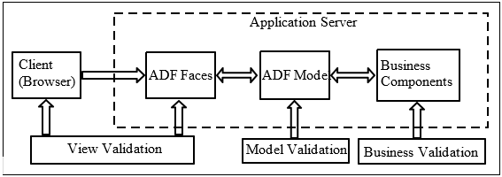
Adding validation rules in a fusion web application
A typical enterprise application may want to perform certain validations at client-side and certain things at server-side. The idea is to detect and report the errors as soon as possible to the end user.
Oracle ADF allows you to perform validations on both client- and server-side
For an ADF web application, you can enable validations at three different layers as follows:
ADF view (ADF Faces)
ADF model
ADF Business Components

Slide 4
Defining validations in the ADF view layer
You can add validation rules to an ADF Faces component used in a web page using one of the following approaches, as appropriate
Enable simple validations for a component using built-in validation attributes
<af:inputText value="#{dpetBean.jobId}" label="Job Id:" columns="5" required="true" maximumLength="5" id="it6"/>
Add more business specific validation for components by EL binding the validator attribute
validator=“#{deptBean.validateDepartmentName}”
public void validateDepartmentName(FacesContext facesContext,
UIComponent uIComponent, Object value){
// IF VALIDATION FAILED:
FacesMessage message = new FacesMessage(FacesMessage.SEVERITY_ERROR,null,
"Department Name is invalid);
throw new ValidatorException(message);
}

Slide 5
Defining a custom ADF Faces validator
Create new Java file
For adding server side validation implement javax.faces.validator.
Moreover for adding client side validation implement org.apache.myfaces. trinidad.validator.ClientValidator.
Step1: Defining client-side validation in JavaScript
Step 2: Defining the validator Java class
Step 3: Configuring and using the validator

Slide 6
Defining a custom ADF Faces validator
Create new Java file
For adding server side validation implement javax.faces.validator.
Moreover for adding client side validation implement org.apache.myfaces. trinidad.validator.ClientValidator.
Step1: Defining client-side validation in JavaScript
Step 2: Defining the validator Java class
Step 3: Configuring and using the validator

Slide 7
Defining validations in the ADF model layer
ADF allows you to add validations in the model (binding layer) layer as well. The model level validations are added on the binding definitions present in a page definition file.
Open the desired page definition file.
Right-click the desired binding item and then select Edit Validation Rule in the context menu.
You can add validations on attribute, list, table, or tree binding entries in the binding section. In the Validation Rule Editor

Slide 8
Defining validations in the ADF Business Components layer
They primarily differ in the execution sequence as explained below
Attribute level
Entity level
Transaction level : If you really want to defer the transaction level validation to the commit phase of a transaction, then set SkipValidation="skipDataControls" in the page definition file of the appropriate JSF page that displays the edit form. This setting causes the framework to skip all transaction-level validations during the post back of a page.

Slide 9
Validations using custom domain objects
To add custom validation logic to the newly built domain class, open the generated domain class in the source editor.
The custom domain class implements the oracle.jbo.domain.DomainInterface interface.
To add validation logic, locate the validate() method in the domain class and add the validation as appropriate.
protected void validate() {//if validation failed.
throw new DataCreationException(CustomErrorMessageBundle.class,
CustomErrorMessageBundle.INVALID_EMAIL,null, null);
}

Slide 10
Creating and registering custom message bundles
Right-click the desired model project in the application navigator and select Project Properties .
ADF Business Components -> Options
Custom Message Bundles to use in this Project, Click on the New button to define a new list bundle class.
final String INVALID_EMAIL = "INVALID_EMAIL";
private static final Object[][] messageKeyValues = new String[][] {
{INVALID_EMAIL, "Invalid Email" }
};

Slide 11
What you may need to know while using custom domain types on the UI
To display custom domain types on the UI, you have to specify an appropriate faces converter for handling the data type conversions back and forth. The ADF framework comes packaged with a generic converter implementation, oracle. genericDomain, which is good enough to handle a number of jbo domain types.
<converter>
<display-name>Generic Domain Converter</display-name>
<converter-id>oracle.genericDomain</converter-id>
<converter-class>
oracle.adfinternal.view.faces.convert.GenericDomainConverter
</converter-class>
</converter>

Slide 12
Displaying validation exceptions on a page
ADF input components, in general, supports automatically displaying their own messages. However, if you want to override the default display of messages (including validation exception), the following ADF Faces components are available for you:
af:message : <af:message for="deptName" id="msg1"/>
af:messages

Slide 13
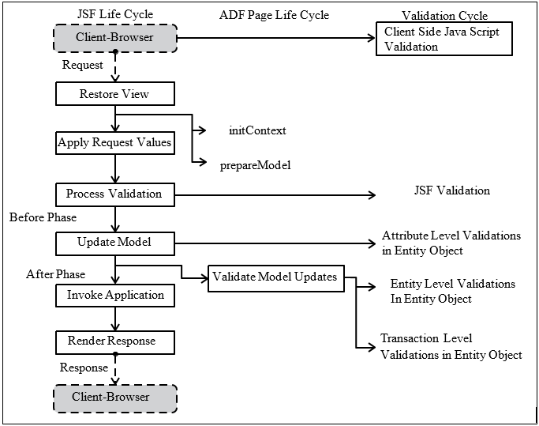
Where in the page lifecycle does validation occur?

Slide 14
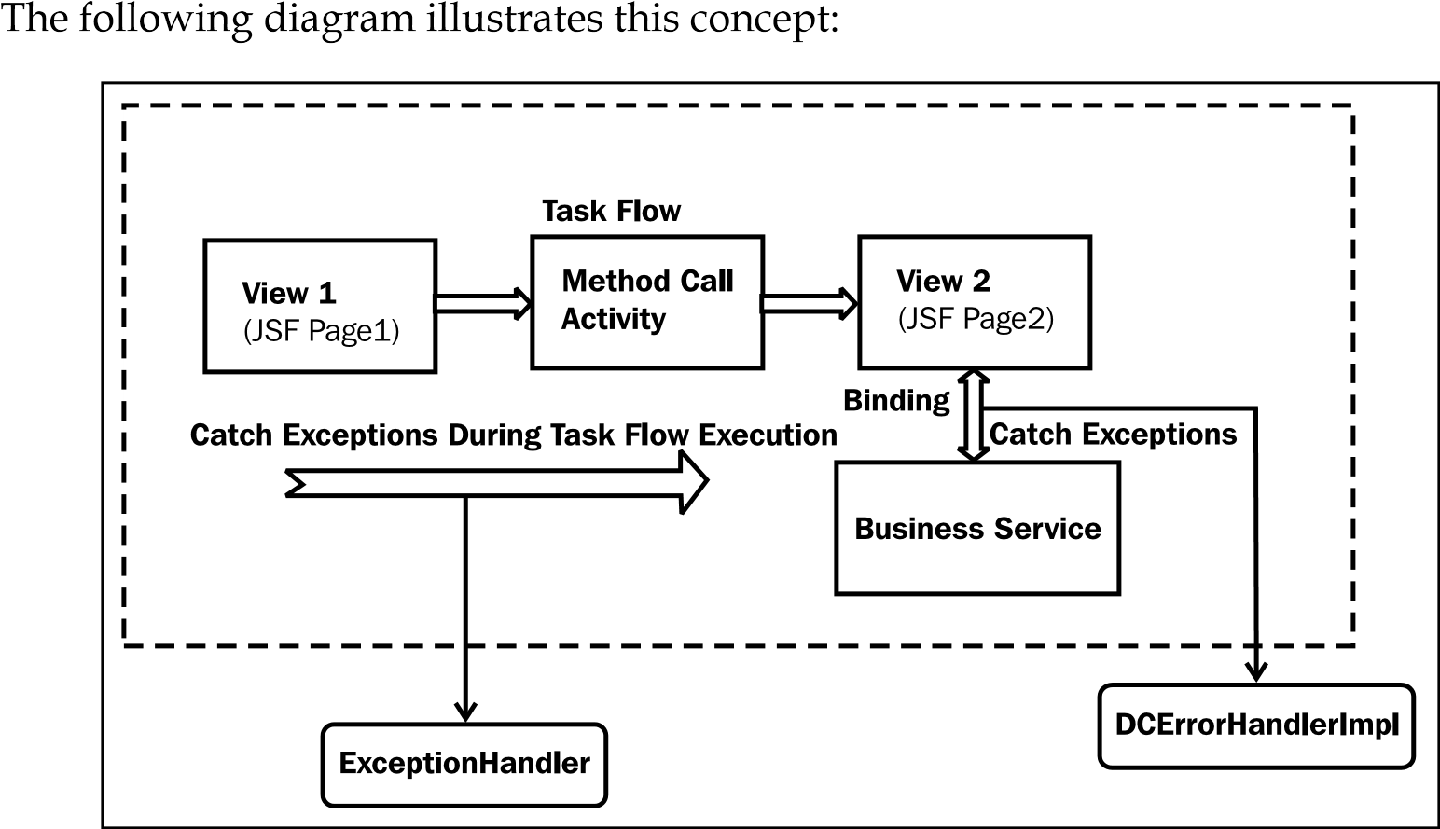
Error handling in ADF

Slide 15
Error handling in ADF
Exception handling in the binding layer: ADF binding layer uses a default oracle.adf.model.binding.DCErrorHandlerImpl class for handling all the exceptions thrown by the business components when invoked through the binding layer
Exception handling in the controller layer: The exceptions handler deployed by the controller layer handles all the exceptions that are raised during the execution of the task flow.
oracle.adf.view.rich.context.ExceptionHandler (in 11G Release 1)
faces.context.ExceptionHandler (in 11G Release 2)
Exception handling in the view layer

Slide 16
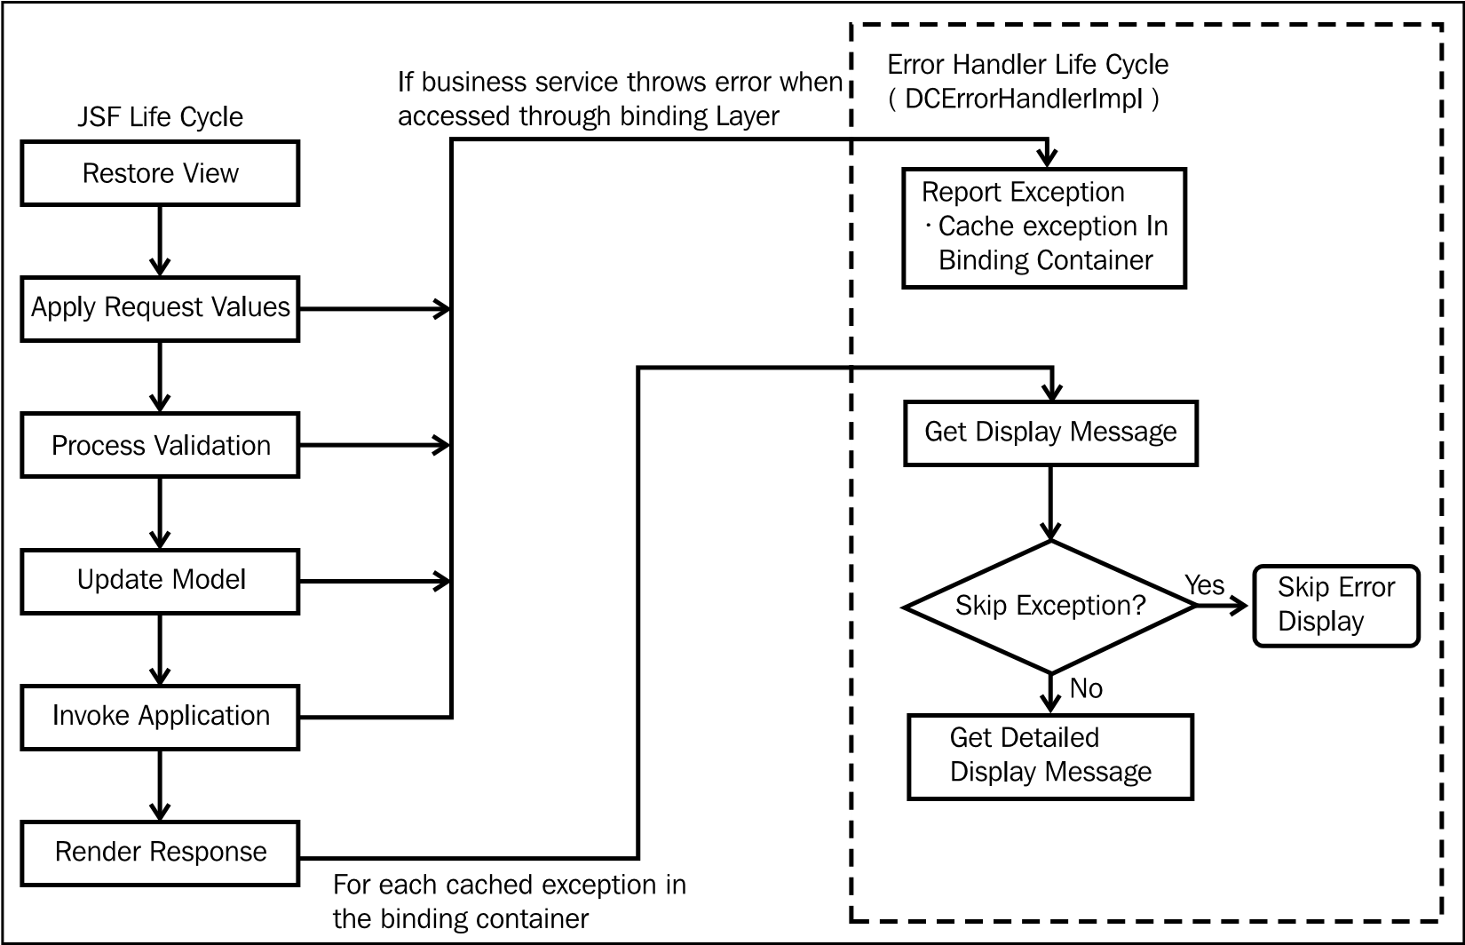
Taking a closer look at DCErrorHandlerImpl

Slide 17
Taking a closer look at DCErrorHandlerImpl
reportException() routine does the following:
Wraps non JboException using the JboException instance
Caches the exception in the binding container allowing the framework to complete the life cycle for the page.
To get error message text for each cached exception, the framework calls getDisplayMessage(BindingContext, Exception)
The getDisplayMessage(BindingContext, Exception) method in turn invokes skipException(Exception) on the error handler implementation for skipping duplicate and irrelevant wrapper exceptions.
getDetailedDisplayMessage(BindingContext, RegionBinding, Exception) on the error handler for reading detailed messages for exception.

Slide 18
Resource bundle usage in the application module
Manually specify the resource bundle entry in the desired application module XML file:
<ResourceBundle>
<PropertiesBundle
PropertiesFile=
"com.packtpub.adfguide.ch11.model.HRDataModelBundle"/>
</ResourceBundle>
Programmatically specify the resource bundle for an application module
protected void finishedLoading() {
super.finishedLoading();
PropertiesBundleDef propBundleDef = new
PropertiesBundleDef(this);
propBundleDef.setPropertiesFile ("com.packtpub.adfguide.ch11.model.HRDataModelBundle");
setResourceBundleDef(propBundleDef);
}
}

Slide 19
Programmatically throwing validation exceptions
throw new ValidationException(deptRow.getAttribute("DepartmentName") + " does not have any employees configured!");
OR
ResourceBundleDef resourceBundle = getResourceBundleDef();
throw new ValidationException(resourceBundle, "ERROR_MESSAGE_NULL_EMPLOYEES", new Object[] {deptRow.getAttribute("DepartmentName") });

Slide 20
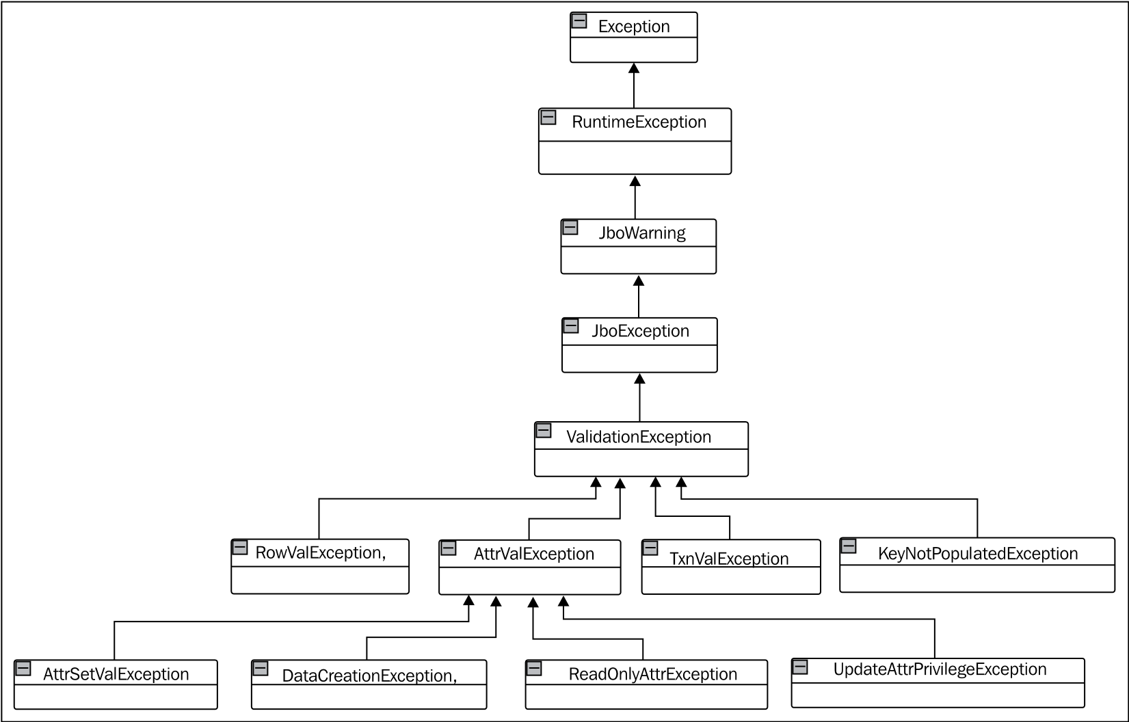
Validation class hierarchy

Slide 21
Wrapping exceptions
ArrayList<RowValException> exceptions = new ArrayList<RowValException>();
exceptions.add(newRowValException("ERROR_MESSAGE_INVALID_EMAIL", employeeEO,null));
exceptions.add(newRowValException ("ERROR_MESSAGE_DEPTNAME_INVALID", deptEO, new Object[]{deptRow.getAttribute("DepartmentName")}));
ValidationException val = new ValidationException (CSMessageBundle.class, CSMessageBundle.EXC_VAL_VR_VALIDATE_FAILED, null);
val.setExceptions((Exception[])exceptions.toArray(new Exception[exceptions.size()]));
//AttrValException ave = new AttrValException (CSMessageBundle.class, //CSMessageBundle.EXC_VAL_VR_VALIDATE_FAILED, e.getStructureDef().getFullName(), "DepartmentName", //deptRow.getAttribute("DepartmentName"), exceptions, false);
throw val;

Slide 22
Customizing default business component error messages
ADF business components allow you to customize default business component error messages, such as unique constraint violation or foreign key constraint violation, by providing an alternative message string for the error code in a custom message bundle
“ORA-00001: unique constraint (HR.EMP_EMAIL_UK) violated” :
“Email is in use”
Step1: Creating and registering a custom message bundle
Step 2: Customizing the DCErrorHandlerImpl
public class CustomErrorHandler extends DCErrorHandlerImpl
protected boolean skipException(Exception ex) {
if (ex instanceof DMLConstraintException) {return false;}
else if (ex instanceof SQLIntegrityConstraintViolationException) {return true;}
return super.skipException(ex); }}
Step 3: Registering the CustomErrorHandler
In the property inspector for the root node of the CPX file, enter the fully qualified name of the custom class that you created as the value for the ErrorHandlerClass field.

Slide 23
Skipping validation Skipping validations in the ADF Faces layer
set immediate property to true for a command component.
use the SkipValidation property associated with the page definition file for bypassing validations initiated through the binding layer
false
custom : then you should specify a CustomValidator implementation in the page definition file . The Bean file that which implements the oracle.binding.BindingContainerValidator
skipDataControls : This setting skips validations defined at transaction level in an entity object
true : all entity level and transaction level validation will skip.

